Slide 1

GURU GHASIDAS VISHWAVIDYALAYA BILASPUR (C.G) (A CENTRAL UNIVERSITY) Dept. of Computer Science And Information Technology (CSIT)
Guided By Submitted By Mr. Nripedra sir Hari Ram
Assistant Professor BSc 5th
CSIT,GGV 17207225
A MINOR PROJECT
ON
VOICE ASSISTANT USING NEURAL NETWORK
GUIDED BY
MR. VIKAS PANDEY SIR
(ASSISTANT PROFESSOR)
SUBMITTED BY
TRILOK DEWANGAN
MCA 2nd SEM
21072165

Slide 2
CONTENTS
INTRODUCTION
OBJECTIVE & OVERVIEW
PROGRAMMING LANGUAGE USED
SOFTWARE AND HARDWARE
DATA FLOW DAIGRAM
SCREENSHOTS
FUTURE ENHANCMENT
CONCLUSION

Slide 3
INTRODUCTION
VOICE ASSISTANT is a DESKTOP APPLICATION developed using PYTHON PROGRAMMING LANGUAGE AND ALSO USED NEURAL NETWORK FOR TRAINING THE DATA. this project is based on the concept of automate our system and control the system by giving voice command. The user can simply install the exe file of the application and use. User can open the application and click to the start button and give command to control the system or do anything by giving voice command. For using this application user need to install this application. And they can use the application. By using NEURAL NETWORK here I have trained the model for text data, this text data contains lots of user input patterns and responses correspondence to that user input. So the neural network enables our model to accept various input pattern and give exact output for that input. We have lots of file to operate our assistant that contain many function and method. Here we have created brain module where we implement neural network architecture model. Also we have created train module from where we train our model with text datasets. Here we also use GUI for better interaction with users.

Slide 4
OBJECTIVE AND OVERVIEWS
The main objective of this application is to reduce the efforts and time to work on the system. By using this application we can control the whole system and another application
By giving single voice command. Its reduce the effort to manually open the application of the system and also reduce the time. We can do all these task while doing anything by giving voice command and get information. We can also use this software in robotics that ease lots of hard work in various field.

Slide 5
PROGRAMMINNG LANGUAGE USED
the voice assistant application has made in python
FEATURES OF PYTHON
Simple and faster.
Open source, case sensitive, platform independent.
Flexibility, security, very efficient.
Flexible data access, real time access monitoring
Quick development.
Quick error detection and correction.
Loosely typed language.
Various module that is important for machine learning
Flutter provide awesome gui for android application

Slide 6
SOFTWARE AND HARDWARE
HARDWARE REQUIREMENT
Processor - 1.9 gigahertz (GHz) x86- or x64-bit dual core processor with SSE2 instruction set
Hard Disk - 1 GB
Main Memory - 500 MB RAM
Display Type -Super VGA with a resolution of 1024 x 768
SOFTWARE REQUIREMENT
• Exe file of the application
• Installed window operating system to use this application
• Browser to get information
• If user does not have exe file, than user need of python software and any ide to access and run the file.

Slide 7
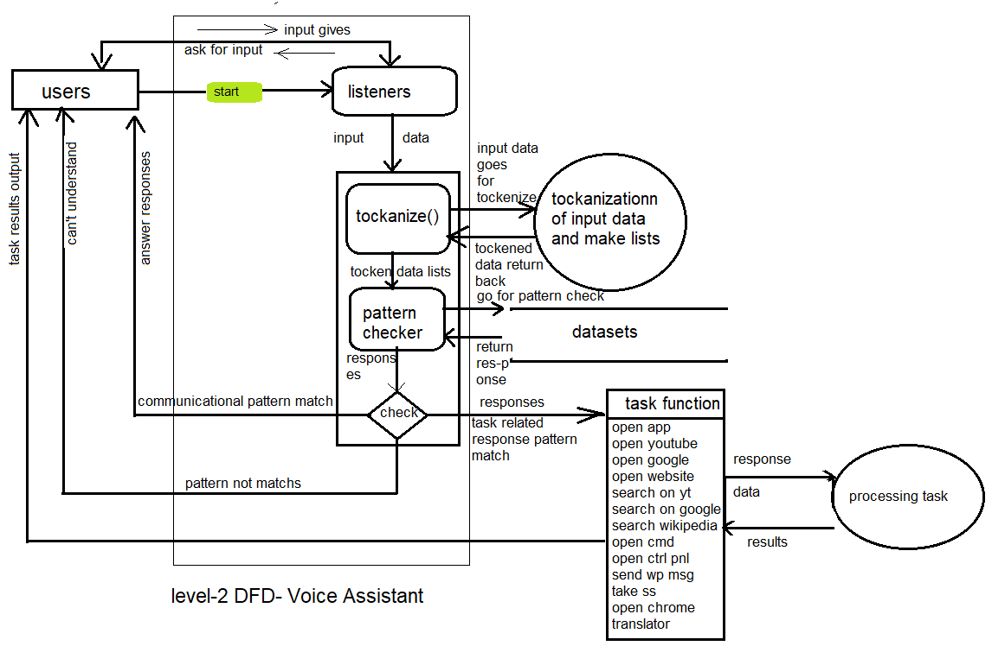
DATA FLOW DIAGRAM

Slide 8
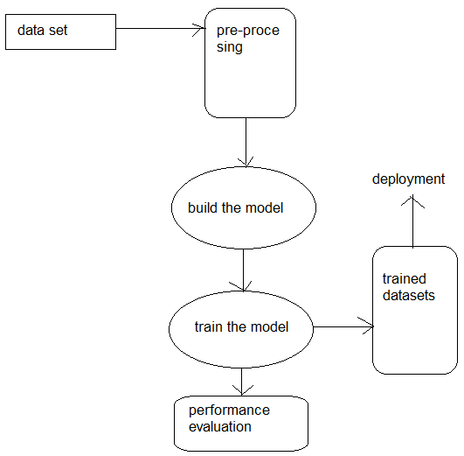
DATA FLOW DIAGRAM MODEL TRAINING

Slide 9
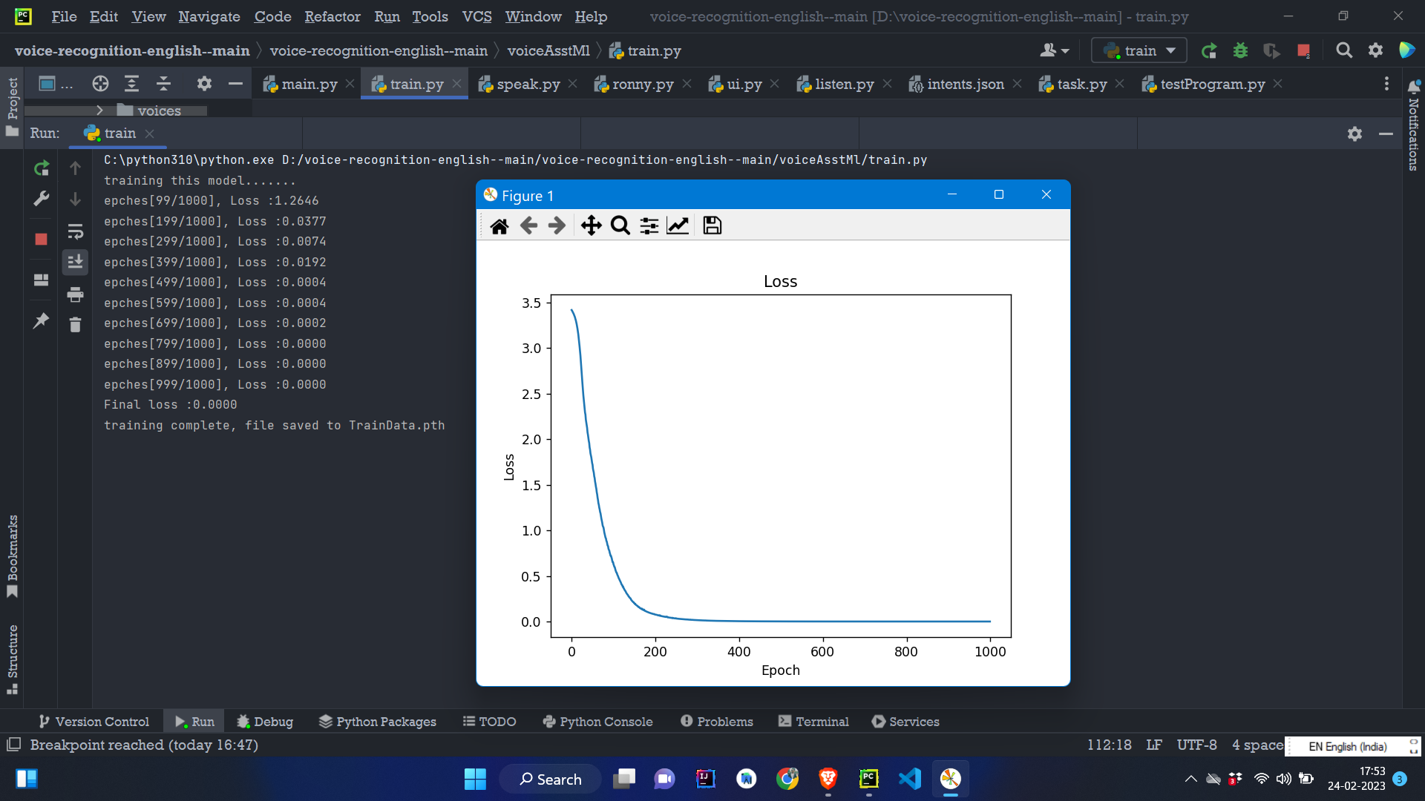
SCREENSHOTS MODEL TRAINING- SINGLE LAYER

Slide 10
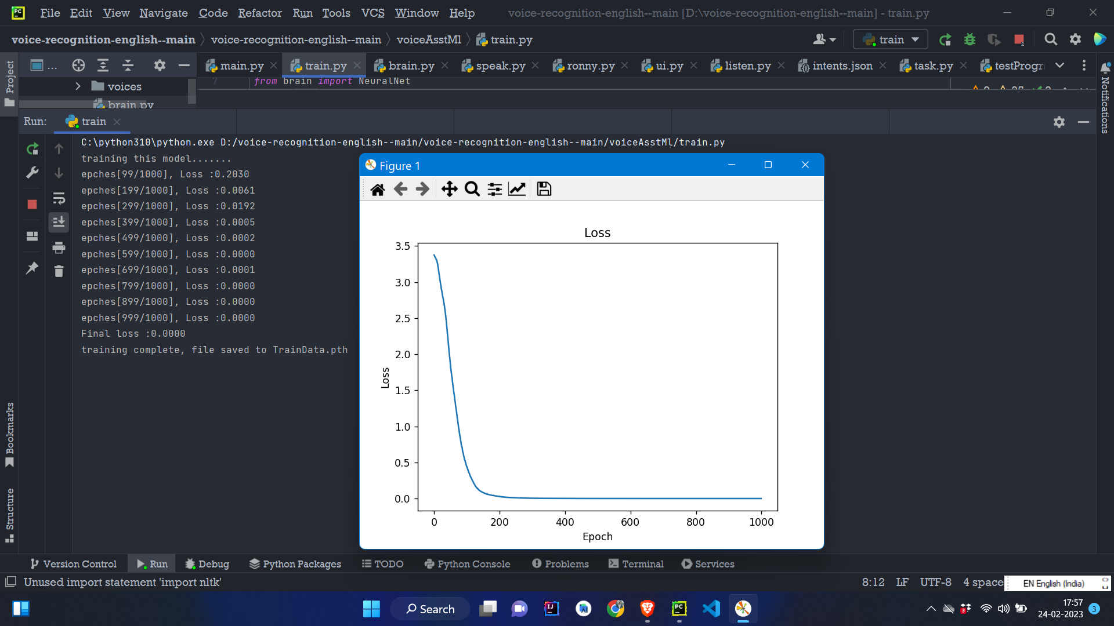
MODEL TRAINING- MULTILAYER NEURAL NETWORK

Slide 11
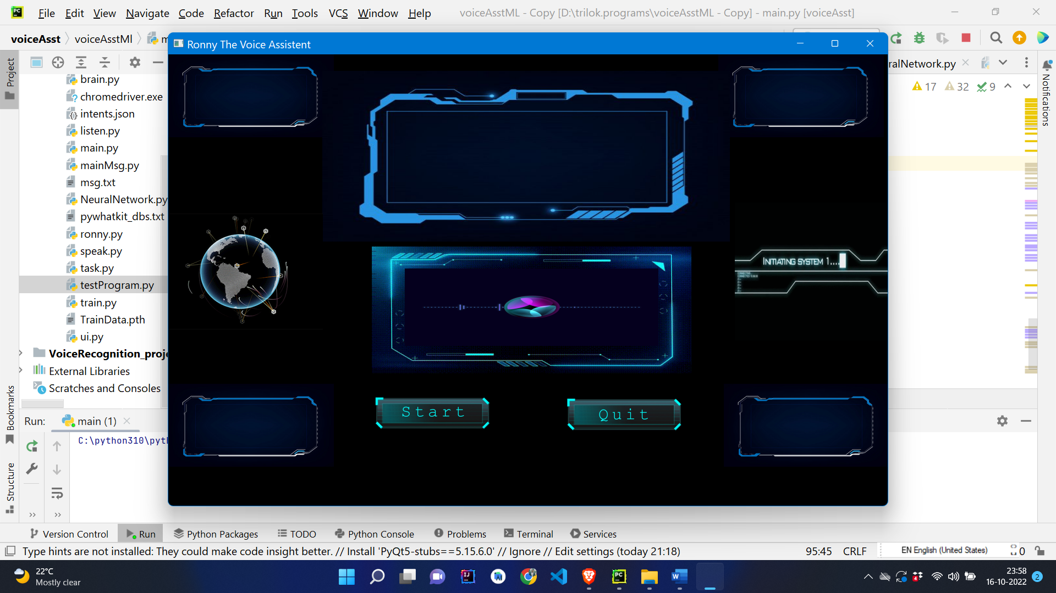
MAIN HOME PAGE

Slide 12
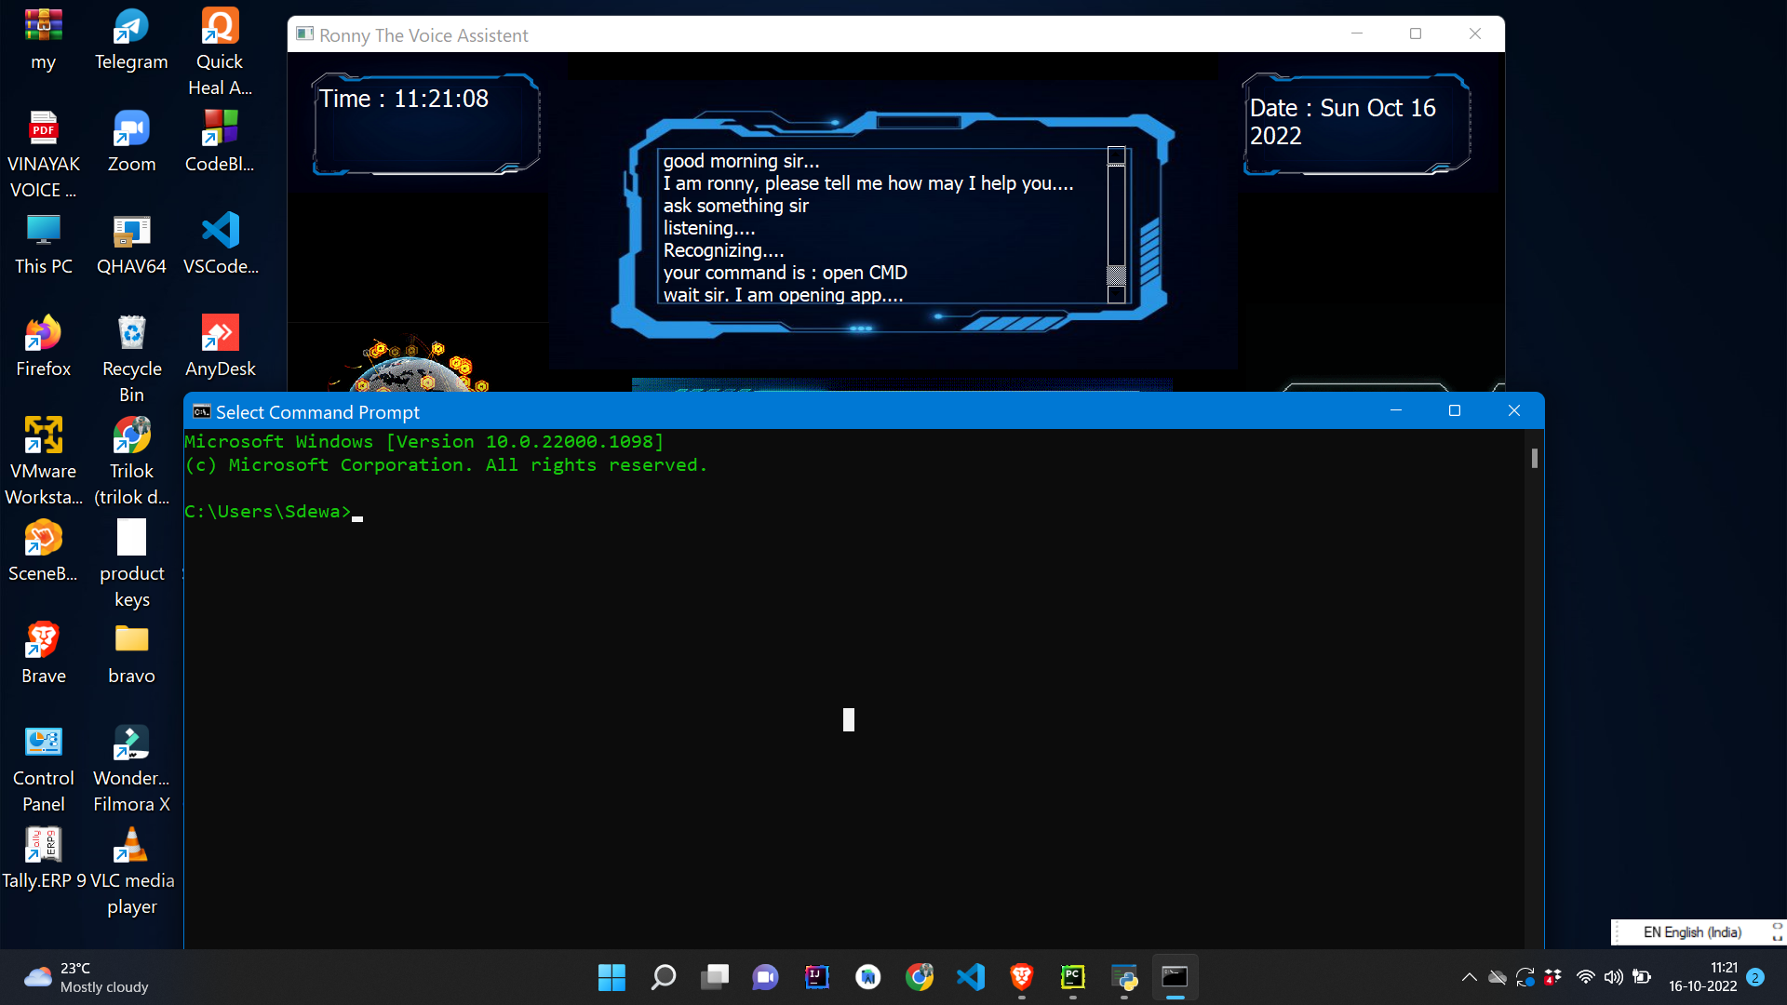
OPENING CMD

Slide 13
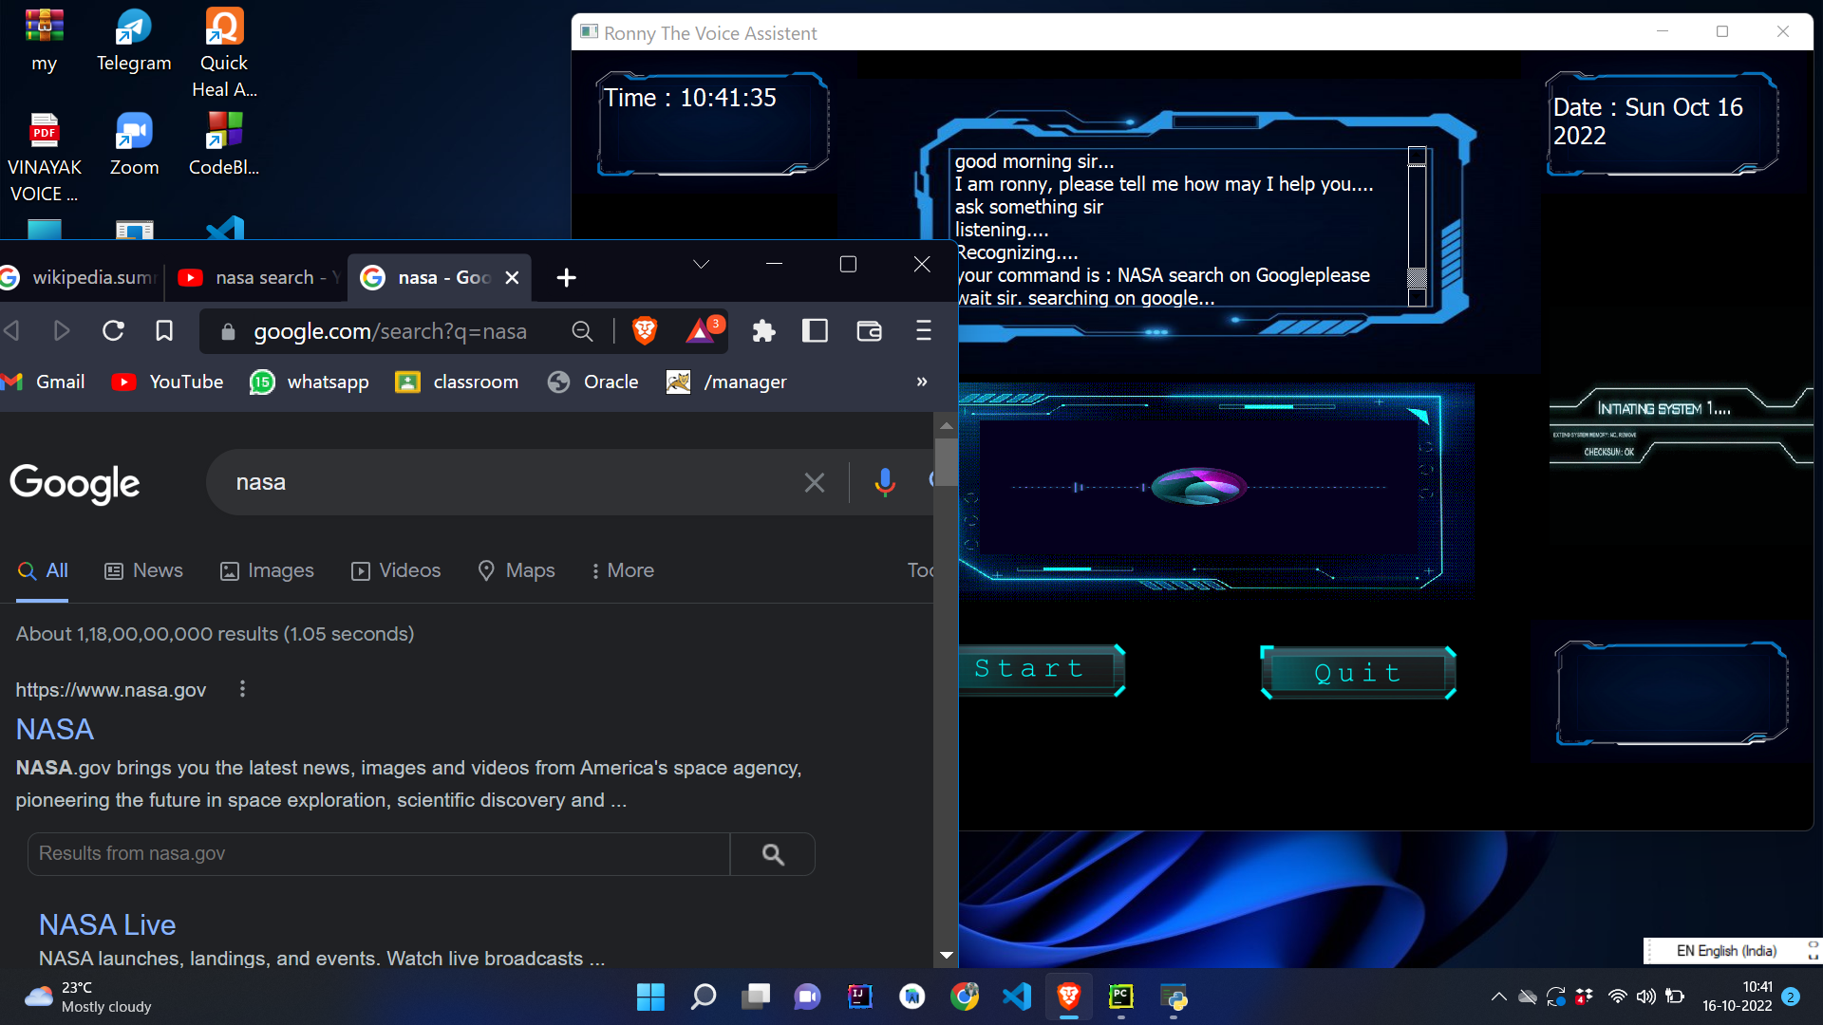
OPENING GOOGLE

Slide 14
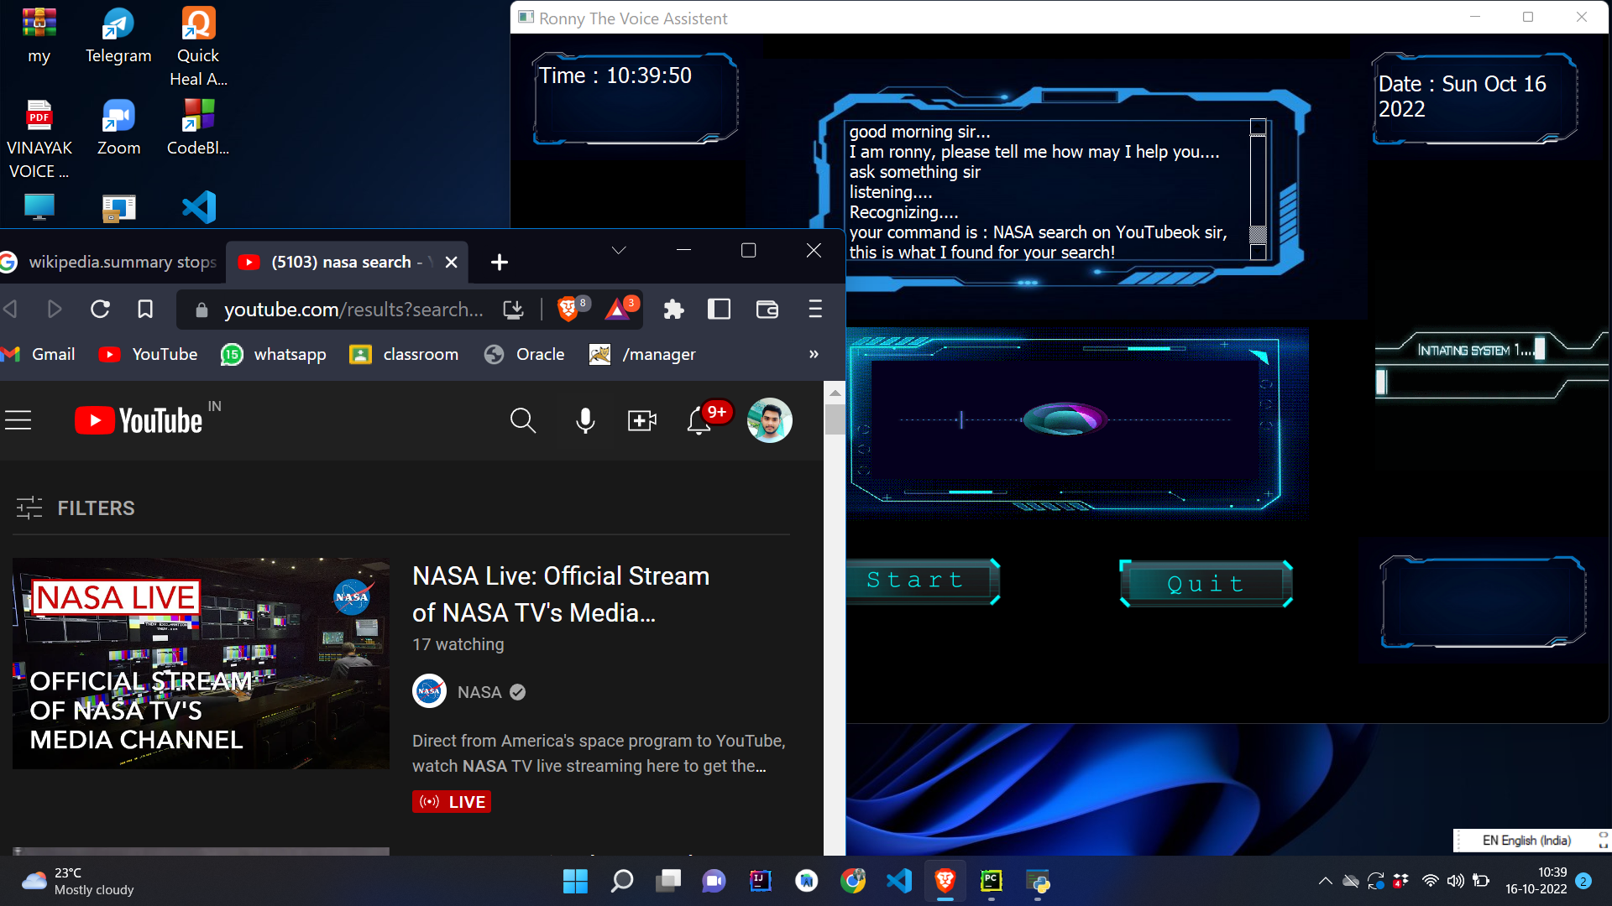
OPENING YOUTUBE

Slide 15
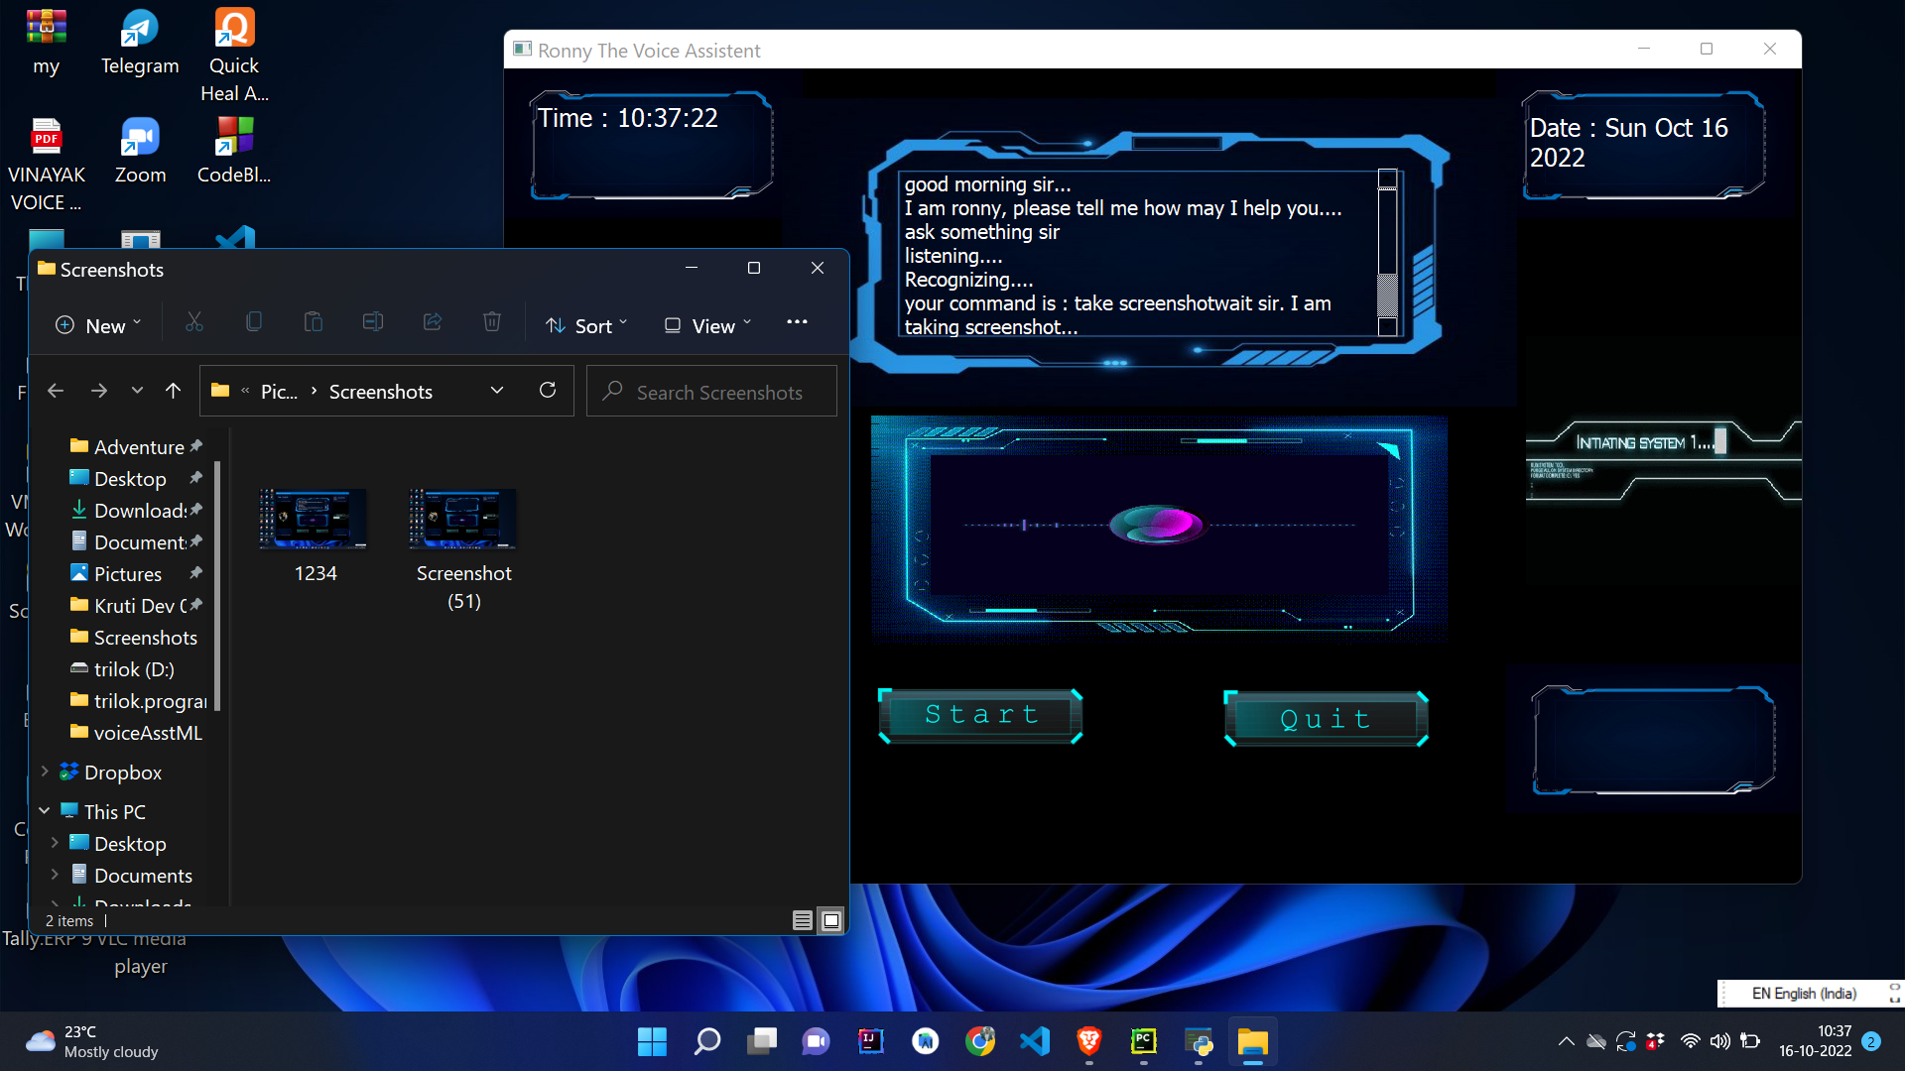
TAKE SCREENSHOT

Slide 16
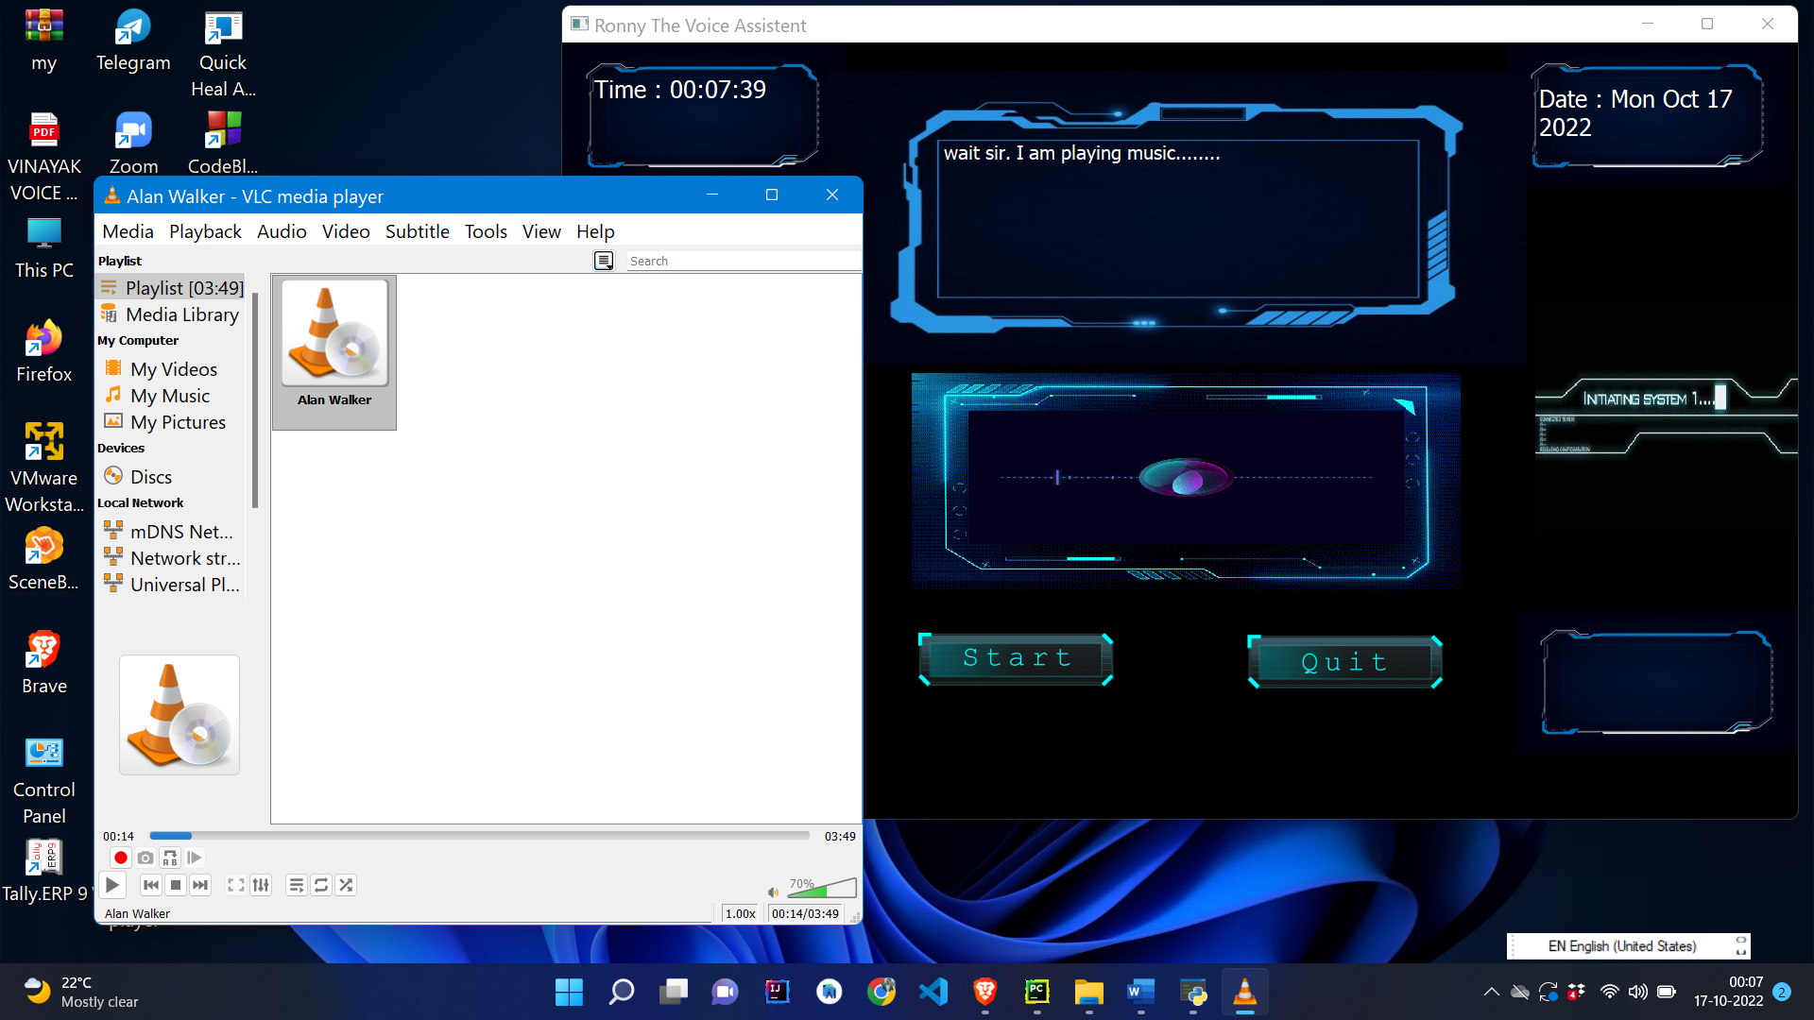
OPENING VLC PLAYER

Slide 17
FUTURE ENHANCEMENT
Data encryption feature will be added in future
Try to reduce response Response
Can be build web and android version of project
Improve UI Design
Universal compatible version will be build for any operating system, this can run only on android os.
Can be added more language in future , currently its detects english language.

Slide 18
CONCLUSION
The main of this project is to convert speech to text our, reduce the time and efforts of manually typing English word and do task by giving Voice speech.
Its try to give effective specific response to the user’s Voice Speech, hence it make communication interesting and interactive.
We can search our result data on web .
There are some limitation encountered and also realized some scope of enhancement in the future which are mentioned below

Slide 19
THANK YOU

